Slide 1
Analyzing NBA Data
Mitchell Silverman
March 29, 2017

Slide 2
Analysis #1 Background
Recently I have been fascinated by how data analysis has changed the way that Basketball is being played
Teams have abandoned outdated strategies and now the game is determined by pace and versatility of players instead of size and brute force

Slide 3
Research Design
Win Shares look at how a player contributed to winning for an entire team
I wanted to look at a player regardless of team and determine if given the same opportunity for playing time, how do other stats help predict whether or not the player will be above or below average
Above or below the mean Win Shares since 1978

Slide 4
Offensive Win Shares
From the website http://www.basketball-reference.com/about/ws.html--in reference to Lebron James 2008-2009 season
Calculate points produced for each player. In 2008-09, James had an estimated 2345.9 points produced.
Calculate offensive possessions for each player. James had an estimated 1928.1 offensive possessions in 2008-09.
Calculate marginal offense for each player. Marginal offense is equal to (points produced) - 0.92 * (league points per possession) * (offensive possessions). For James this is 2345.9 - 0.92 * 1.083 * 1928.1 = 424.8. Note that this formula may produce a negative result for some players.
Calculate marginal points per win. Marginal points per win reduces to 0.32 * (league points per game) * ((team pace) / (league pace)). For the 2008-09 Cavaliers this is 0.32 * 100.0 * (88.7 / 91.7) = 30.95.
Credit Offensive Win Shares to the players. Offensive Win Shares are credited using the following formula: (marginal offense) / (marginal points per win). James gets credit for 424.8 / 30.95 = 13.73 Offensive Win Shares.
Notes:
Credit Basketball_r

Slide 5
Defensive Win Shares
From the website http://www.basketball-reference.com/about/ws.html--in reference to Lebron James 2008-2009 season
Calculate the Defensive Rating for each player. James's Defensive Rating in 2008-09 was 99.1.
Calculate marginal defense for each player. Marginal defense is equal to (player minutes played / team minutes played) * (team defensive possessions) * (1.08 * (league points per possession) - ((Defensive Rating) / 100)). For James this is (3054 / 19780) * 7341 * ((1.08 * 1.083) - (99.1 / 100)) = 202.5. Note that this formula may produce a negative result for some players.
Calculate marginal points per win. Marginal points per win reduces to 0.32 * (league points per game) * ((team pace) / (league pace)). For the 2008-09 Cavaliers this is 0.32 * 100.0 * (88.7 / 91.7) = 30.95.
Credit Defensive Win Shares to the players. Defensive Win Shares are credited using the following formula: (marginal defense) / (marginal points per win). James gets credit for 202.5 / 30.95 = 6.54 Defensive Win Shares.
Notes:
Credit Basketball_r

Slide 6
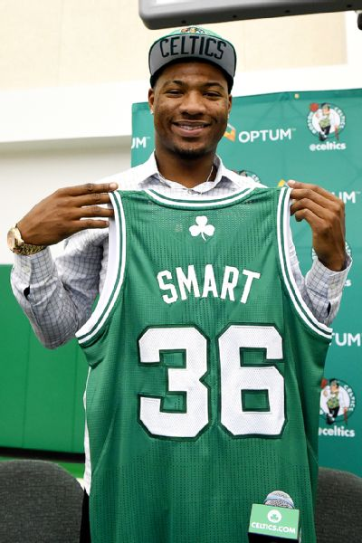
Research Design
Do I have SMART goals?
Specific
Measurable
Attainable
Reproducible
Time Bound
Notes:
looking at the dimensions of whether a player was an above or below average player and other major statistical categories. I will run these models once by position and then again by age
Points, Rebounds, Assists Steals, Blocks, eFG%
Measurable –I have all player stats by season from 1979-2016
Attainable—Using the binary variable of win shares above or below average I will use a linear regression to look at the impact of all the stats on win shares and then run a random forest to predict my data
Reproducible—I should be able to plug in data from new seasons as they come along
Time Bound—This is bound by the history of stats keeping and how many seasons there have been in the NBA

Slide 7
Research Design
I acquired all of my data from a website called www.basetball-reference.com
I was able to export all major stats by player by season since 1978 (when the league expanded on what statistics they were keeping for players)
I used this data to construct my exploratory analysis and then filtered it down for modeling purposes
I had to do some minor formatting changes in order to ensure that position data was uniform throughout the analysis

Slide 8
Exploratory Analysis
Questions I originally wanted to answer
What is the age where basketball players are at their most valuable?
i.e. when do players have the highest mean Win Shares?
How Does Position effect winning and contribute to winning?
The league has gone through different phases where different positions are considered the most valuable
What is the distribution by position and age in the NBA for highest win shares?

Slide 9
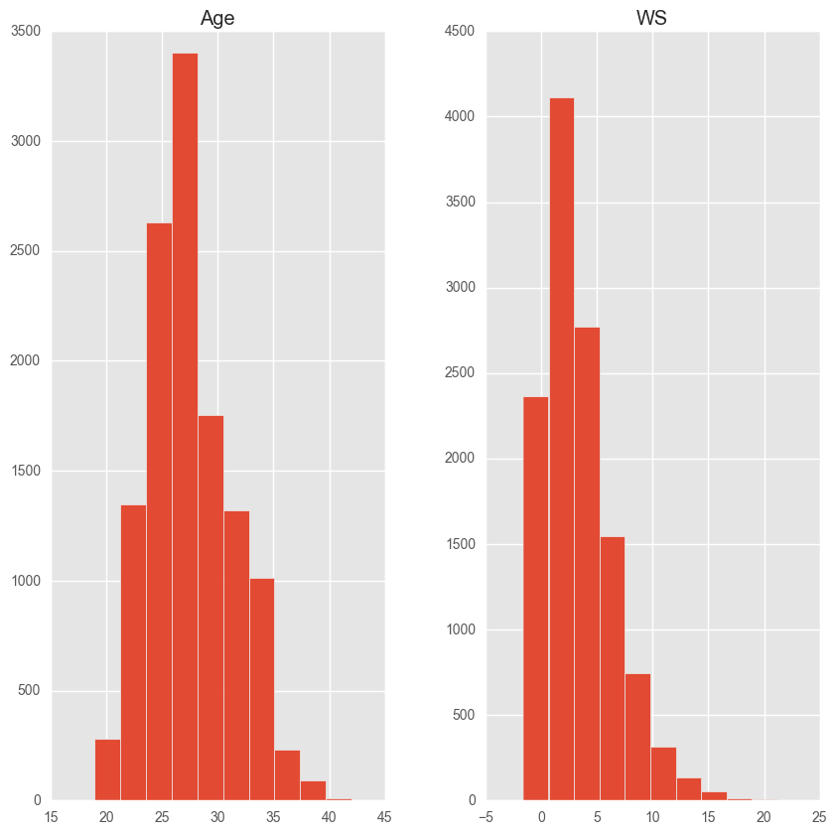
Exploratory Analysis

Slide 10
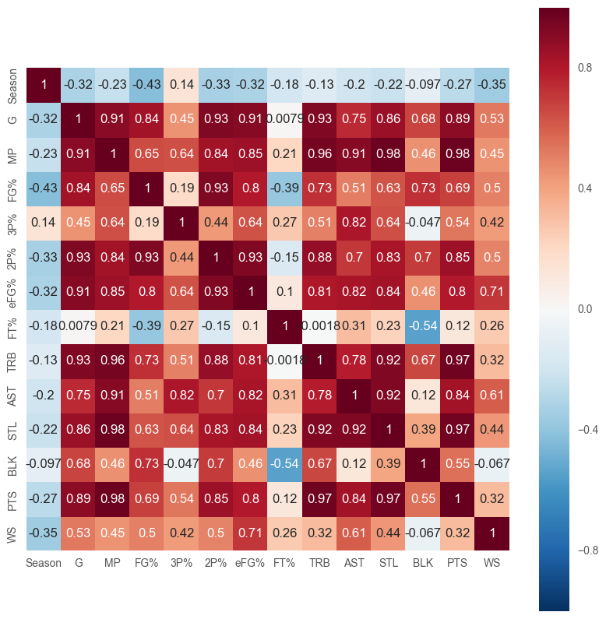
Exploratory Analysis

Slide 11
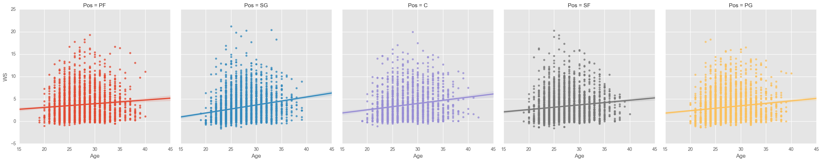
Exploratory Analysis

Slide 12
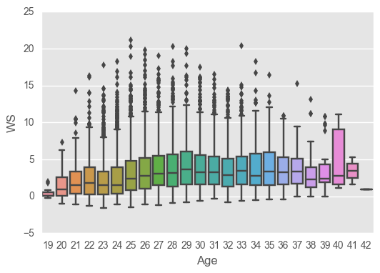
Exploratory Analysis

Slide 13
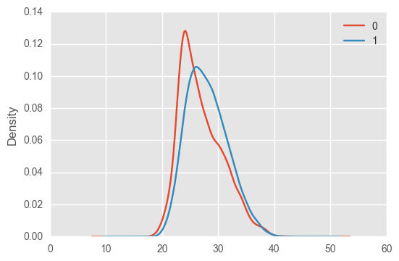
Exploratory Analysis
Once I figured out the Mean Win Shares for everyone in the league, I looked at a binary field of whether a player was above the mean or not
This is the distribution of the above field by age

Slide 14
Model Development
I standardized all of my metrics using the scaler function in Scikit Learn
I created dummy variables for the two different models I built
By Position
By Age
I dropped all objects from my data set

Slide 15
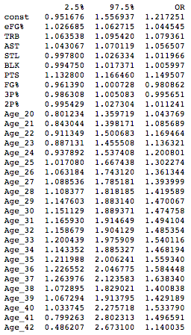
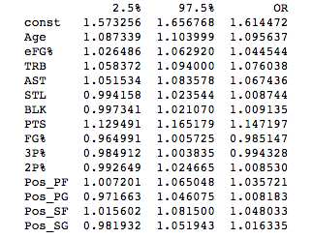
Logistic Regression Results by Position
Logistic Regression
Results by Age

Slide 16
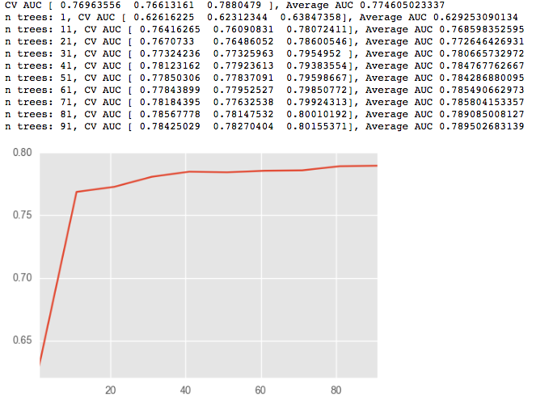
Here are my Output values from my Random Forest Model by position with an AUC Score of
0. 709292

Slide 17
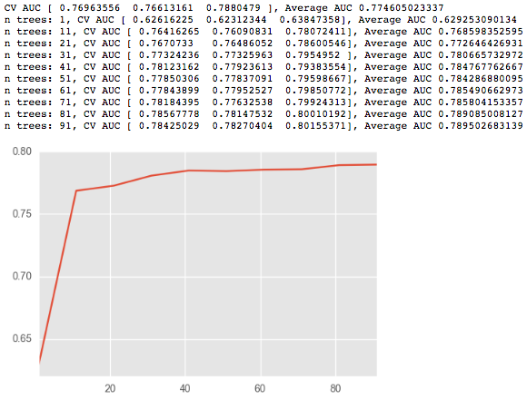
Here are my Output values from my Random Forest Model by age with an AUC Score of
0. 730163

Slide 18
Analysis Number 2
I recently read an article on espn.com called “The Tinderization of the NBA”
This article details how players are going out less on the road and using technology to meet woman on the road instead of drinking at a club and staying out late
I decided to check the writers math using a series of logistic regressions on NBA data using some code I found from this blog
https://tomaugspurger.github.io/modern-5-tidy.html

Slide 19
Model Development
I trained my model by looking at a teams win percentage at home and away based on the number of days they had for rest in between games
This allows me to see how big of a difference there is in win percentage when a team has the same amount of rest before a home game and an away game

Slide 20
Results
I cleaned the data for 2 of my favorite NBA seasons in different eras of the league vs the current season
First I looked at the 1986 season when there were no chartered planes or cell phones
Second I looked at the 1998 season where some amenities started becoming available to players
Lastly I looked at the current NBA season where players have full access to chartered flights, unlimited data plans, and modern physical therapy equipment that can travel with them

Slide 21
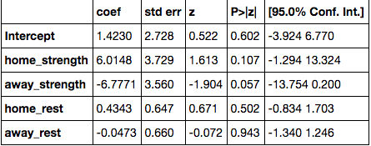
Results Set Season 1986
1986

Slide 22
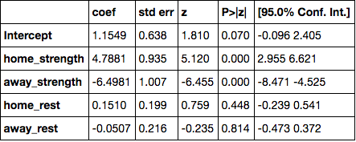
Results Set Season 1998
1998

Slide 23
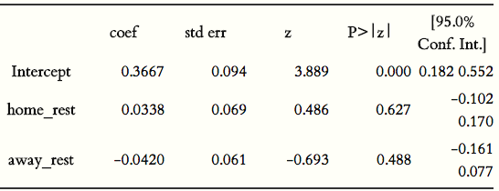
Results Set 2016 Season
2016

